Slide 1

Model-View-Controller Architecture
Presented by:
Elizer Ponio Jr.

Slide 2
Outline
Introduction
Model
View
Controller

Slide 3
Model-View-Controller
The Model-View-Controller (MVC) is a well-known design pattern in the web development field.
It is way to organize our code.
It specifies that a program or application shall consist of data model, presentation information and control information.
The MVC pattern needs all these components to be separated as different objects.

Slide 4
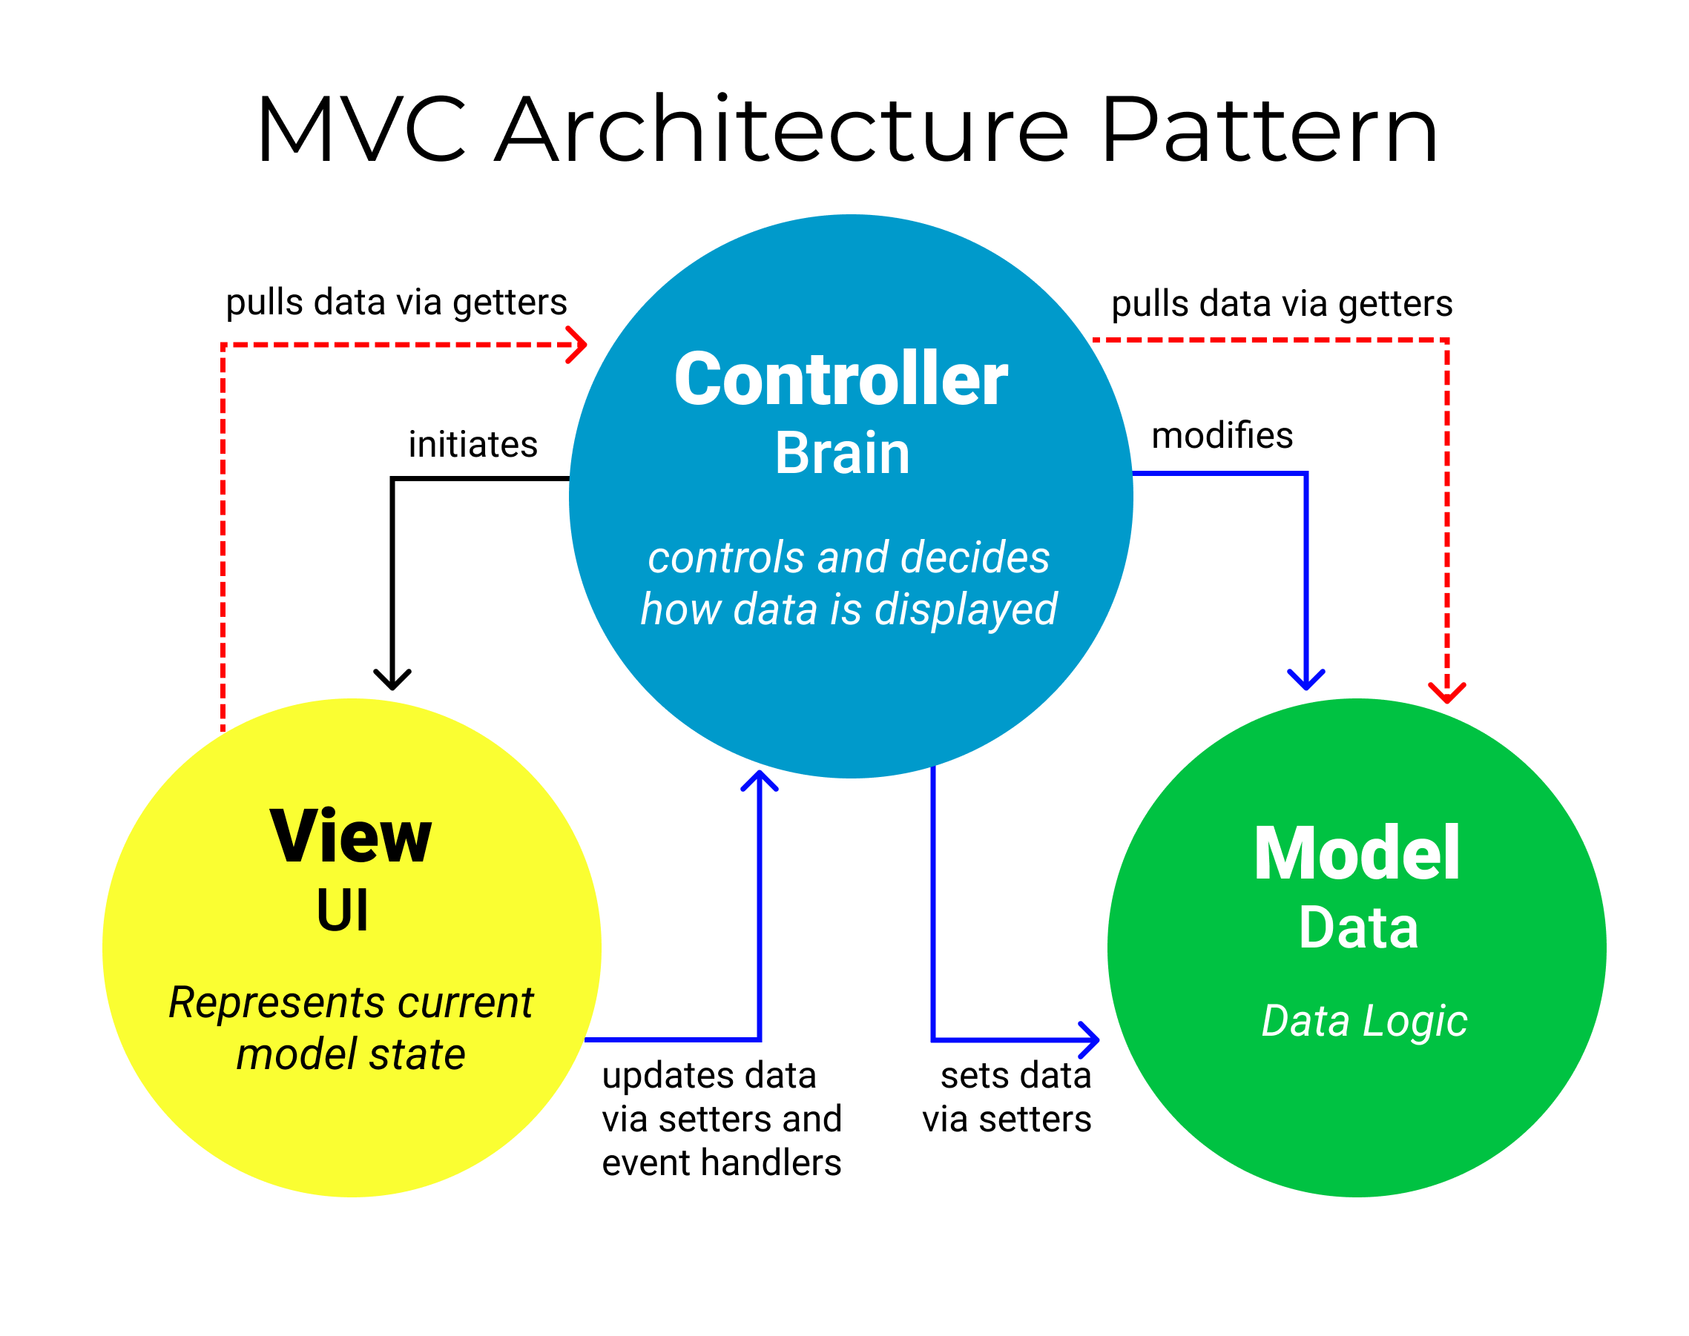

Slide 5
Outline
Introduction
Model
View
Controller

Slide 6
Model Layer
It represents the business layer of application.
The model represents the data and the rules that govern access to and updates of this data.
In the context of JavaFX, this layer contains all classes and interfaces.

Slide 7
Outline
Introduction
Model
View
Controller

Slide 8
View Layer
It represents the presentation layer of application.
It is used to visualize the data that the model contains.
The view renders the contents of a model. It specifies exactly how the model data should be presented.
In the context of JavaFX, this layer contains all fxml files.

Slide 9
Outline
Introduction
Model
View
Controller

Slide 10
Controller Layer
It works on both the model and view.
It is used to manage the flow of application.
It translates the user's interactions with the view into actions that the model will perform.
In a stand-alone GUI client, user interactions could be button clicks or menu selections.
In the context of JavaFX, this layer contains all controller files.

